Slide 1


Elite league App
Python – SQL – HTML – CSS - project
20.04.2023

Slide 2

Agenda
Brief – sports app
Why - the reason
Design – uml - diagrams
Demo - browser
Code – the search for games
Questions / Feedback

Slide 3

Brief
Sport Scoring App
MVP:
* The app should allow the user to create, edit and remove teams in the league
* The user should be able to create new games
* There should be a way to display all the games for a team and all the teams involved in a game
* The app should display if a game was won or lost
Possible Extensions:
* Create a league table to see who is on top of the league
* Add players to teams and let them have game stats (points won, fouls, etc.)
* Anything else you can think of

Slide 4

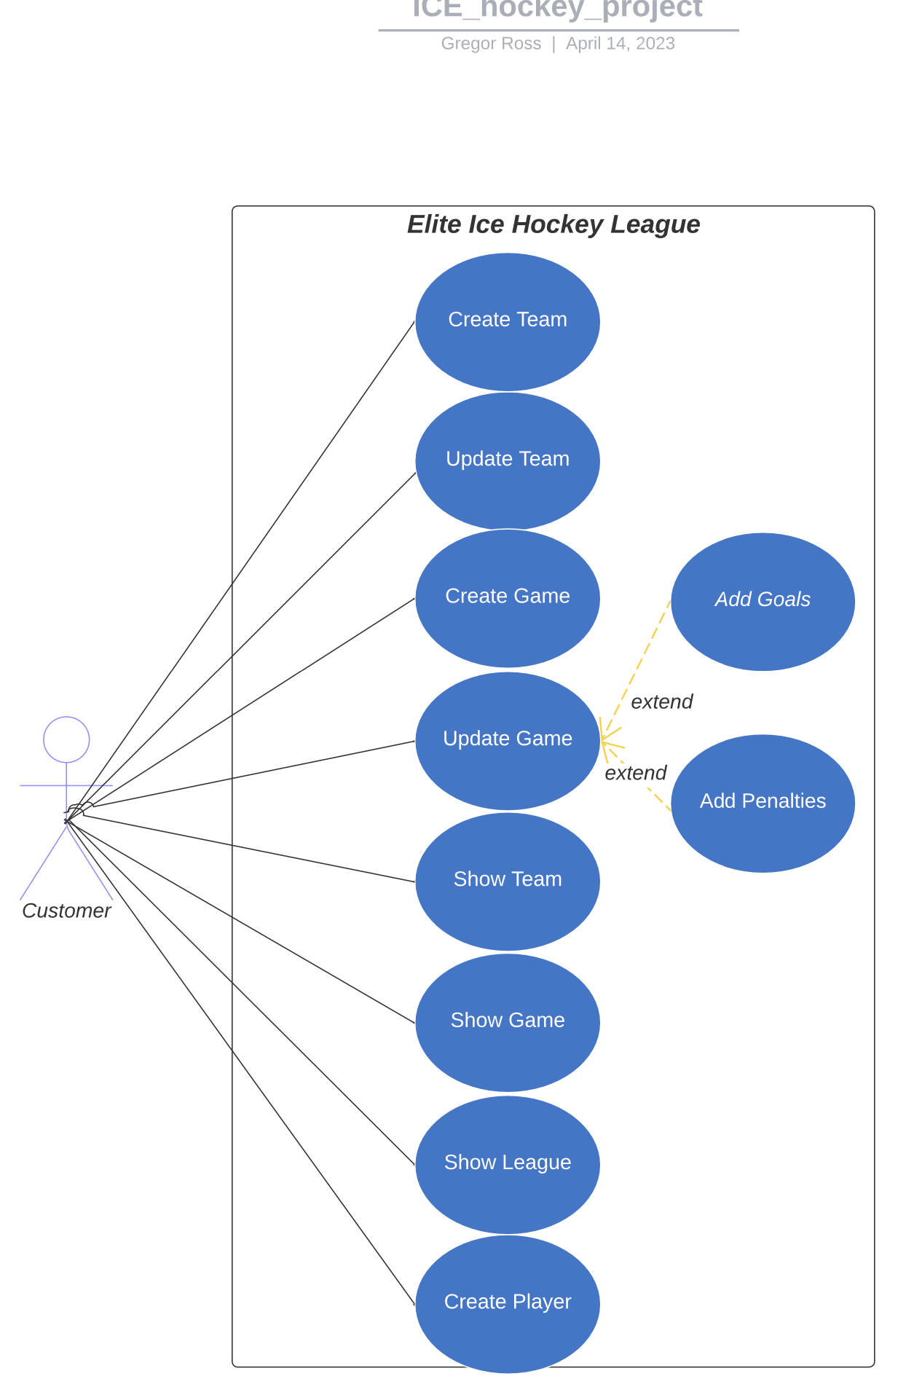
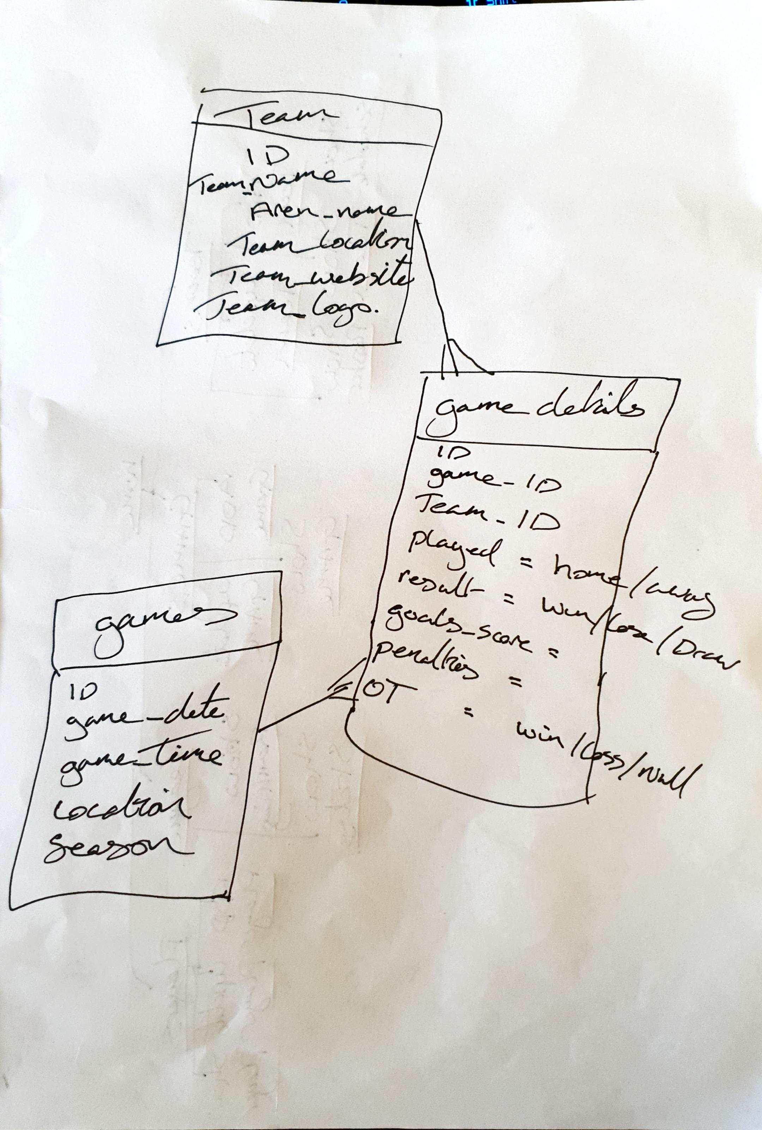
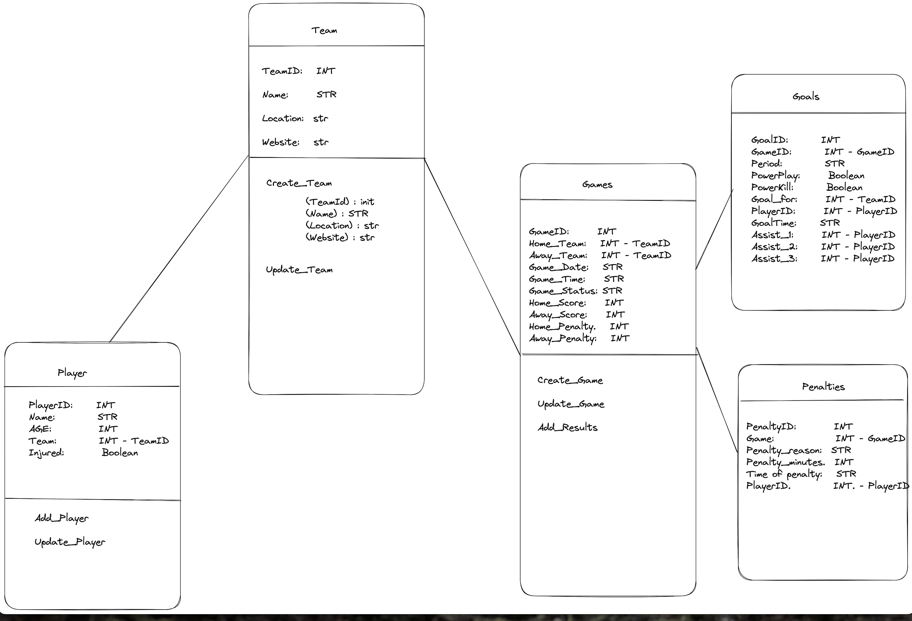
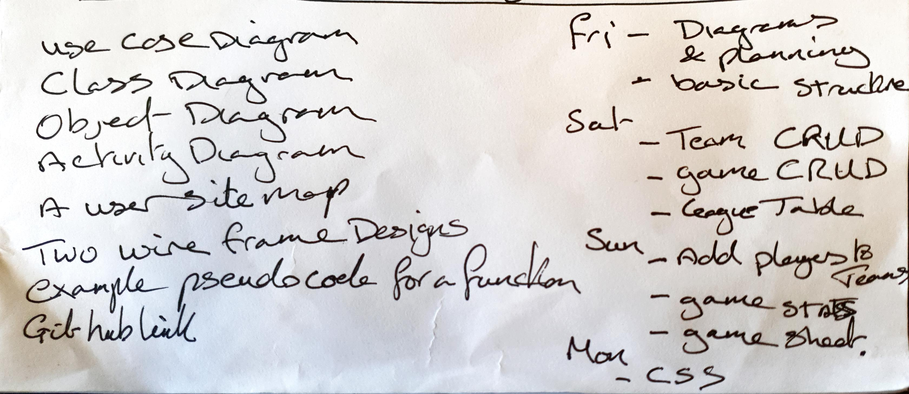
Design
The UML
Planning my idea out
The Diagrams
Getting my structure right to do what my ideas were
Confirming I am on the right track
The Friday zoom call before 15:00 hrs
Rough diagrams that kept me sane
Saturday was a challenge…

Slide 5

Demo
Let’s Dive In

Slide 6
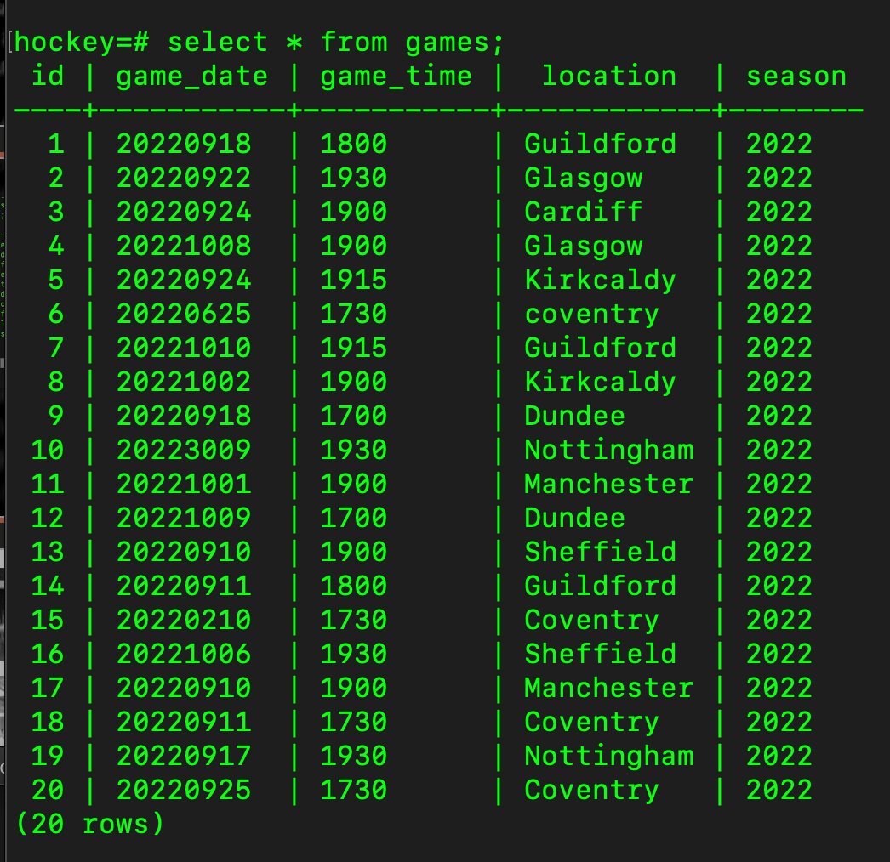
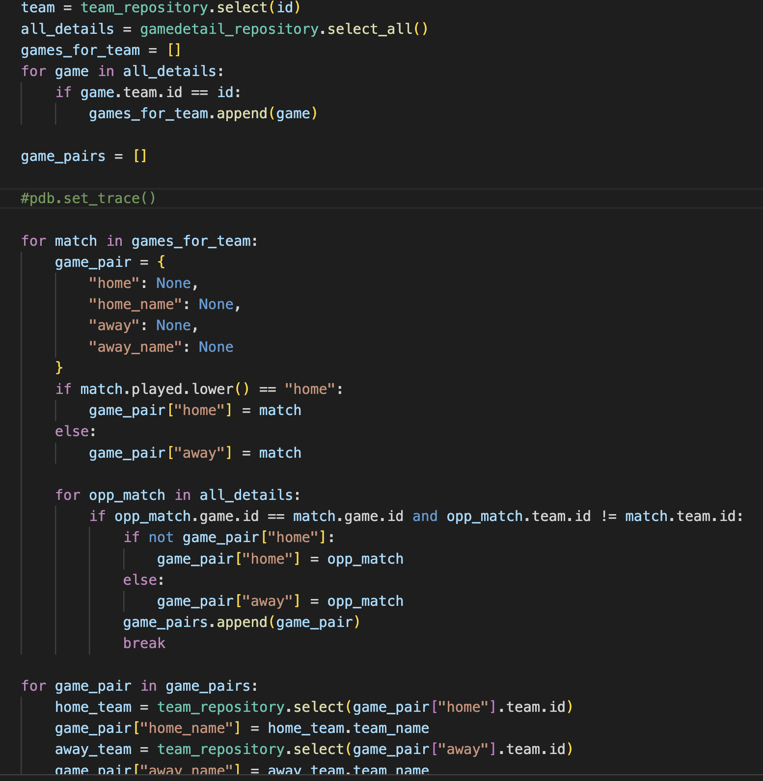
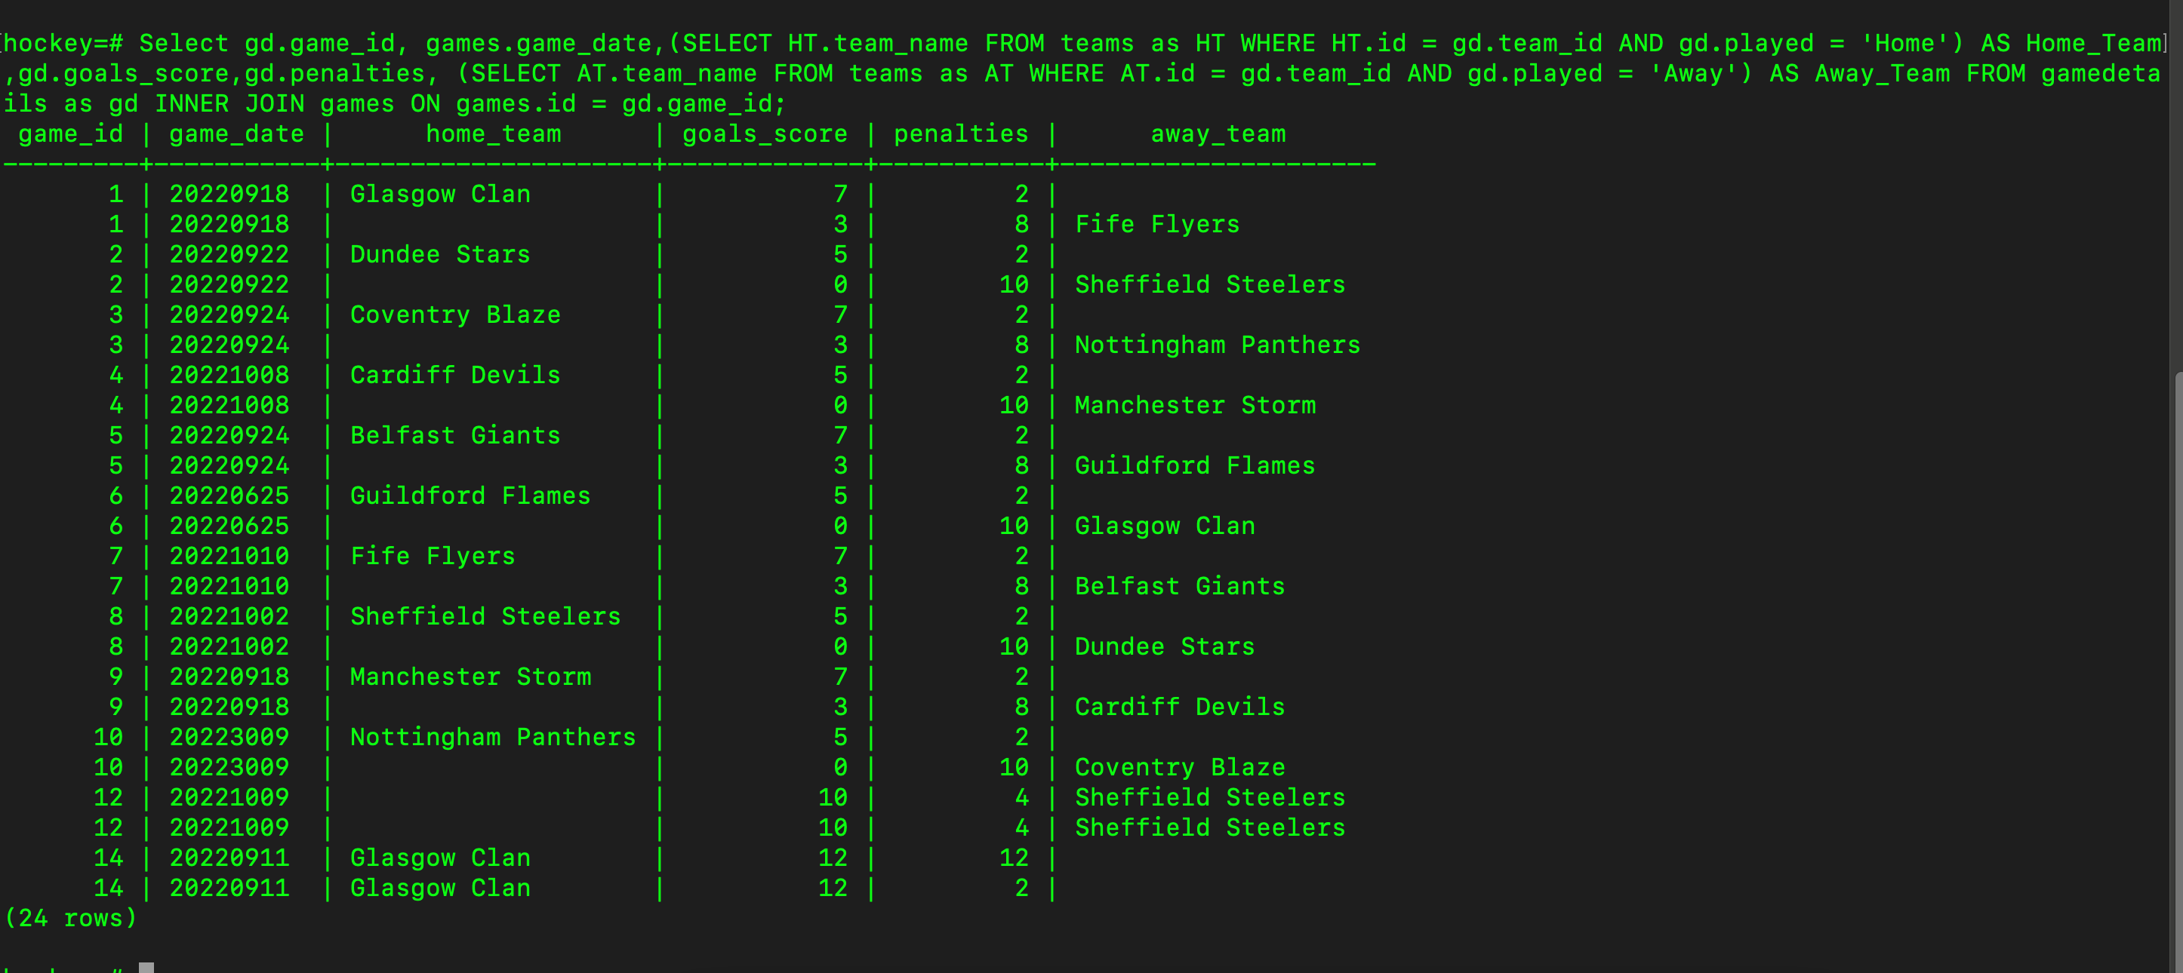
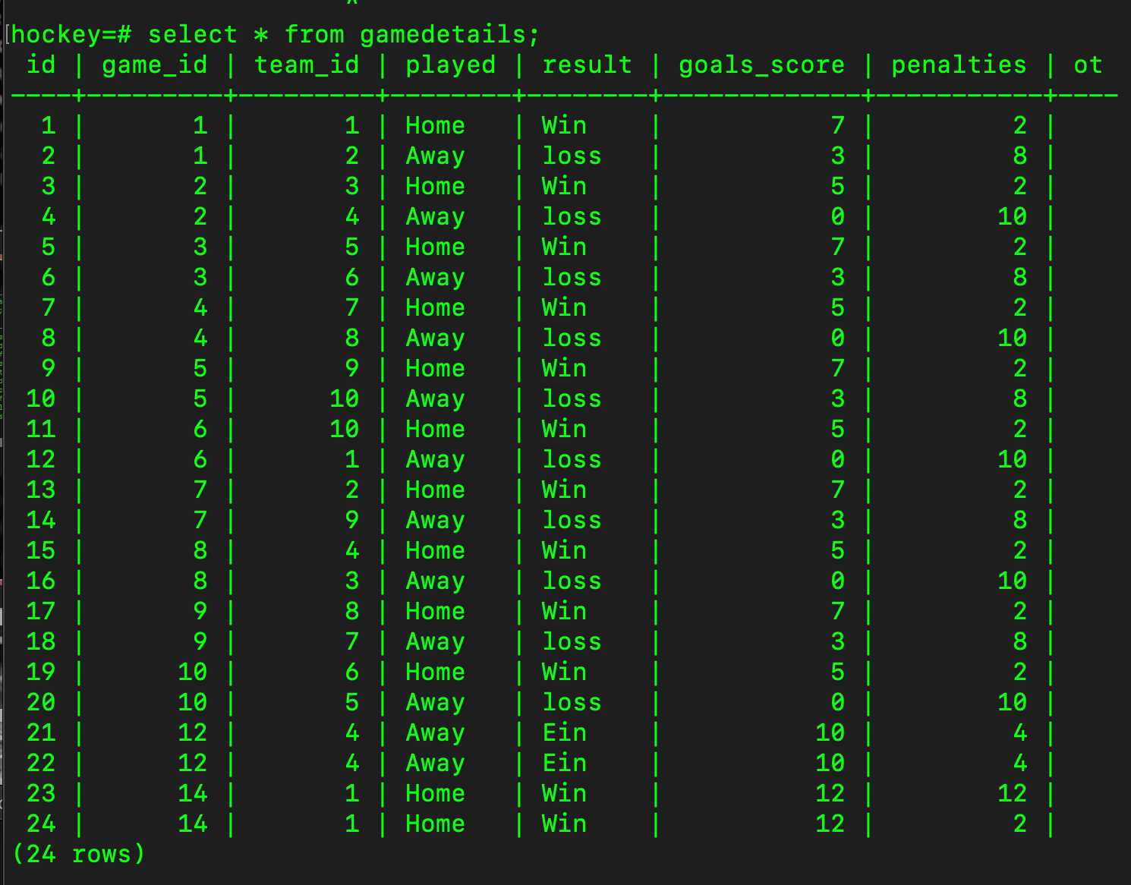
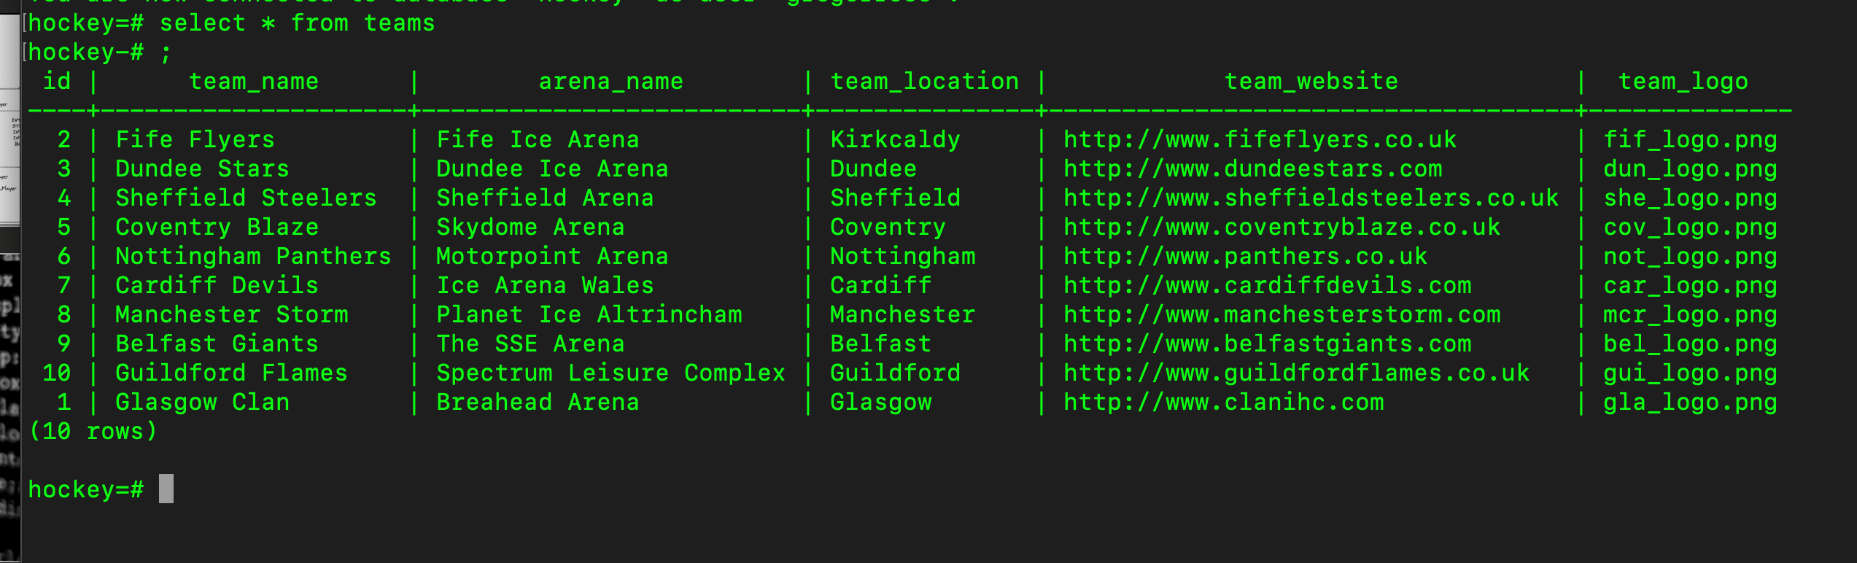
The Pain
The search for Games...

Slide 7

What’s next
LOOKING AHEAD

Slide 8



Questions / Feedback / comments
Gregor Ross
Linked in / facebook
gregor.home@btinternet.com
www.still_to_make_this.com

